Slide 1
Kinematics
MS864M

Slide 2

Kinematics
Kinematics is a part of mechanics that describe the motion of objects.
The simplest type of motion is motion in a straight line.
An example of motion in straight line is that of a car moving on a straight horizontal road.

Slide 3
Motion diagram
A motion diagram is a pictorial representation of the positions of a particle with respect to time.
It is useful for beginners, but is restricted to very simple motions.
In the figure below, the object is moving at 2.0 m/s to the right and its position changed from 0 m to 10.0 m in 5 s.
0
1
2
3
4
5
+x
Scale : 1 box = 1 m
Origin

Slide 4
Position in 1D
To simplify calculations, we represent objects as points so that other types of motion such as rotation and vibration can be ignored.
To describe the motion of an object in 1D, we may choose the x-axis with an origin O.
The position vector is the vector pointing from the origin O to the point P.
O
P
x axis

Slide 5
Positive displacement in 1D
Suppose the object moves from P₁ to P₂, where P₁ is nearer to O than P₂.
The displacement vector is the change in position vector.
Hence is a vector pointing from P₁ to P₂ .
The magnitude or size of the displacement vector is the distance x₂ − x₁.
O
P₁
P₂
x axis

Slide 6
Negative displacement in 1D
Suppose the object returns to its original position, where P₁ is farther from O than P₂.
The displacement vector, is a vector pointing from P₁ to P₂ .
The size of is the distance |x₂ − x₁|.
The absolute sign is used because magnitude or size is a positive quantity and x₂ is less than x₁.
O
P₂
P₁
x axis

Slide 7
Distance vs displacement
Distance is the total length of the path travelled by an object. It is a scalar.
In the diagram below, if the object moves from P₁ (origin) to P₂ (10.0 m) and back to P₁ again, the distance is 20.0 m
The first displacement vector is 10.0 m to the right and the second displacement vector is 10.0 m to the left.
The final displacement vector with respect to the origin is 0 m.
O
P₁ (0 m)
P₂ (10.0 m)
x axis

Slide 8

Average velocity in 1D
Velocity is defined as the rate of change of displacement.
If the rate of change of displacement is not constant, we calculate the average velocity.
Hence average velocity is
points in the direction of .
P₁ (x₁)
P₂ (x₂)
O
x axis

Slide 9
Negative average velocity in 1D
In the diagram below, P₁ is further than P₂. Hence x₂ is less than x₁.
The displacement is negative, and hence the velocity is also negative.
O
P₂ (x₂)
P₁ (x₁)
x axis

Slide 10
Illustrations of average velocity in 1D
O
P₁ (19 m)
P₂ (258 m)
x axis
t₁ = 1.0 s
t₂ = 4.0 s
O
P₂ (19 m)
P₁ (258 m)
x axis
t₂ = 4.0 s
t₁ = 1.0 s

Slide 11
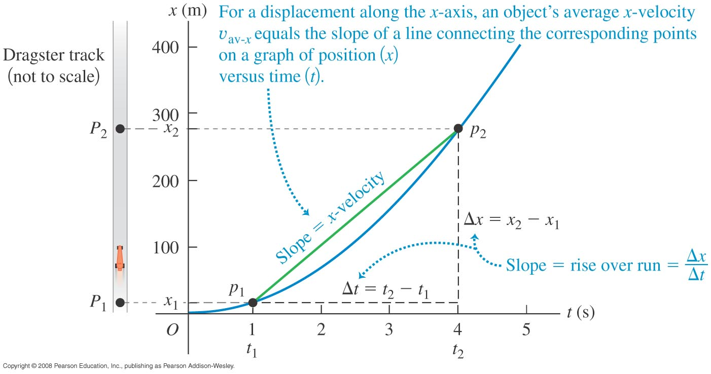
Average velocity from x-t graph
The magnitude of the average velocity can be found from the slope of the straight line joining two points on the position-time (x-t) graph.

Slide 12
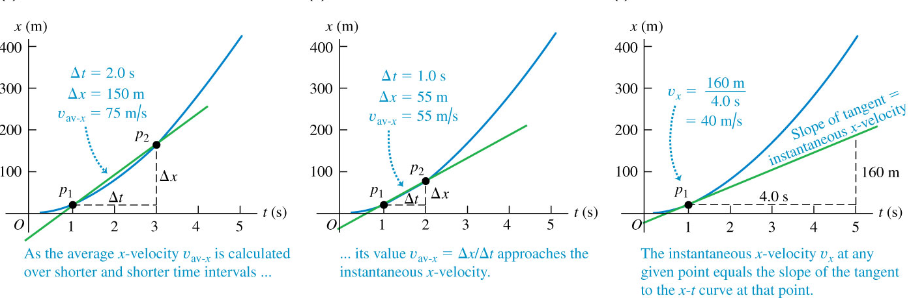
Instantaneous velocity from x-t graph
Average velocity cannot tell us the velocity of the object at a given instant of time.
The instantaneous velocity is defined as

Slide 13
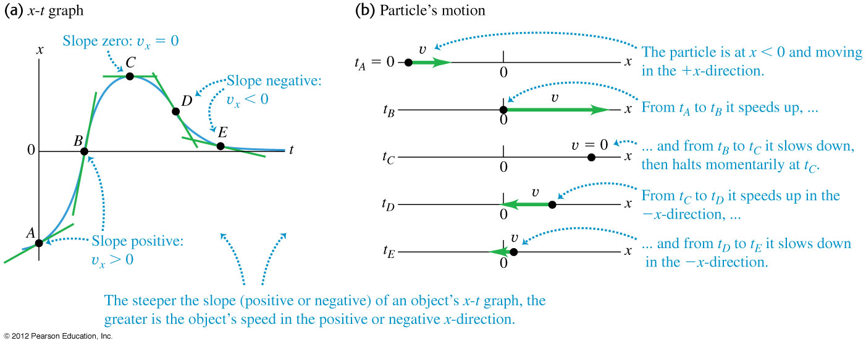
Instantaneous velocity from x-t graph
Since instantaneous velocity is the gradient of the tangent to the x-t curve, the sign of the gradient gives the direction of the object’s motion.

Slide 14
Average velocity vs instantaneous velocity
Unless specified, the term velocity implies instantaneous velocity.
Suppose an object moves to the right according to x(t) = 3.0t².
x(1.0) = 3(1.0)² = 3.0 m

Slide 15
Example 1
A body moves along the positive x-axis according to the function x(t) = 3t² + 2t. a) What is
i) the distance travelled in 1.0 s?
ii) the displacement at 1.0 s?
iii) the average velocity between 0 to 1.0 s?
b) Derive the instantaneous velocity function and find the instantaneous velocity at 0 s and 1.0 s.
a) i) Distance = 3(1.0)² + 2(1.0) = 5.0 m.
ii) Displacement = 5.0 m.
iii) Average velocity .
b) Instantaneous velocity function = 6t + 2.
Hence
and

Slide 16
Acceleration
Acceleration is defined as rate of change of velocity.
The average acceleration is defined as the change in instantaneous velocity divided by the time taken.
Hence average acceleration points in the direction of .
The SI unit of average acceleration is m/s².
If the rate of change in velocity is constant, then the acceleration is constant and written as .

Slide 17
Equation of motion (constant acceleration)
When the acceleration is uniform or constant, we can derive simple equations to describe the object’s motion.
Let the velocity at t = 0 be v_{0x}.
Let the velocity at time t be v_{x}.
For constant acceleration,
Rearranging gives

Slide 18
Equation of motion (constant acceleration)
Let the position at t = 0 be x₀.
Let the position at a time t be x.
The magnitude of the average velocity is
Since the acceleration is constant, v_{av-x} is also given by
Hence

Slide 19
Equation of motion (constant acceleration)
Simplifying we get the equation
Using the formula , we get another useful relation.
Note that the equations we just derived are applicable only when the acceleration is constant and the object is moving in a straight line.

Slide 20
Graphs of uniform velocity
Displacement
Velocity
Acceleration
0
0
0
Time
Time
Time
a) Displacement increases linearly with time.
b) Velocity remains the same with time.
c) Acceleration is zero.

Slide 21
Graphs of uniform acceleration
Displacement
Velocity
Acceleration
0
0
0
Time
Time
Time
a) Displacement increases non-linearly with time.
b) Velocity increases linearly with time.
c) Acceleration is non zero and constant with time.

Slide 22
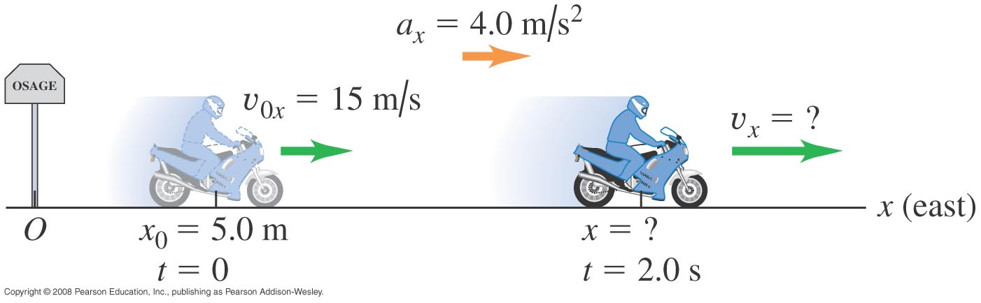
Example 2
A motorcyclist heading east through a small town accelerates at a constant 4.0 m/s² after he leaves the city limits. At time t = 0 he is 5.0 m east of the city-limits signpost, moving east at 15 m/s.
a) Find his position and velocity at t = 2.0 s. b) Where is he when his velocity is 25 m/s?
Notes:
a) x = 43m, v = 23 m/s b) x = 55 m

Slide 23
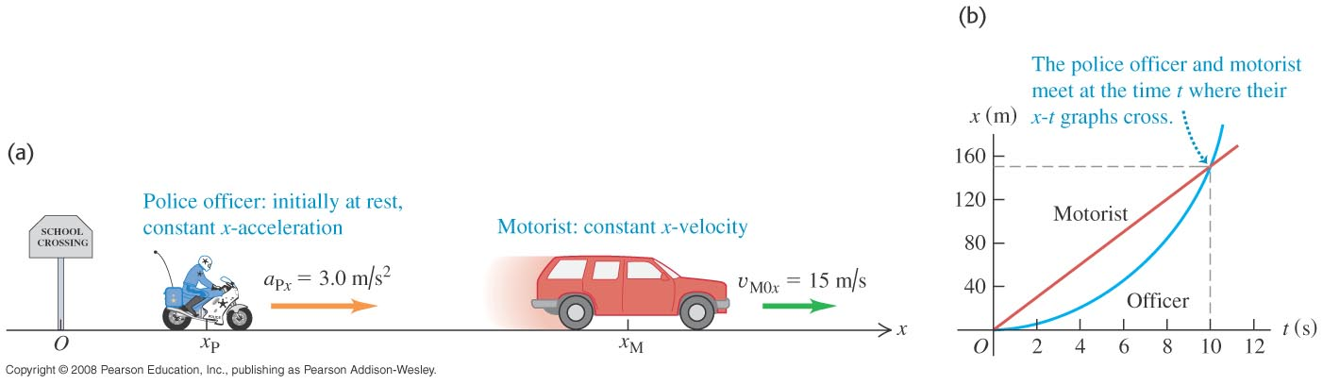
Example 3 Done
A motorist travelling with a constant speed of 15 m/s passes a school-crossing corner where the speed limit is 10 m/s. Just as the motorist passes the school-crossing sign, a police officer on a motorcycle, initially at rest, starts in pursuit with a constant acceleration of 3.0 m/s².
a) How much time elapses before the officer passes the motorist? T = 10s b) At that time, what distance has each vehicle travelled? S = 150 meters
Notes:
a) 10 s b) 150 m

Slide 24
Free fall motion with constant acceleration
Free fall motion is when an object falls under earth’s gravity assuming that
there is no air resistance,
the distance of the fall is small compared to the radius of the earth,
the rotation of the earth is ignored.
The acceleration due to gravity is taken to be constant irrespective of the size and mass of the object.
For earth, the magnitude of the acceleration due to gravity is 9.80 m/s².

Slide 25
Example 4
You throw a ball vertically upward from the roof of a tall building. The ball leaves your hand at a point even with the roof railing with an upward speed of 15.0 m/s. On its way back down, it just misses the railing.
a) Find the ball’s position and velocity 1.00 s and 4.00 s after leaving your hand.
b) Find the ball’s velocity when it is 5.00 m above the railing.
c) Find the maximum height reached.
d) Find the ball’s acceleration when it is at its maximum height.
e) At what time after being released has the ball fallen 5.00 m below the roof
Notes:
a) +10.1m, +5.2 m/s, -18.4 m, -24.2 m/s b) +11.3 m/s, -11.3 m/s c) +11.5 m d) -9.80 m/s² e) 3.36 s

Slide 26
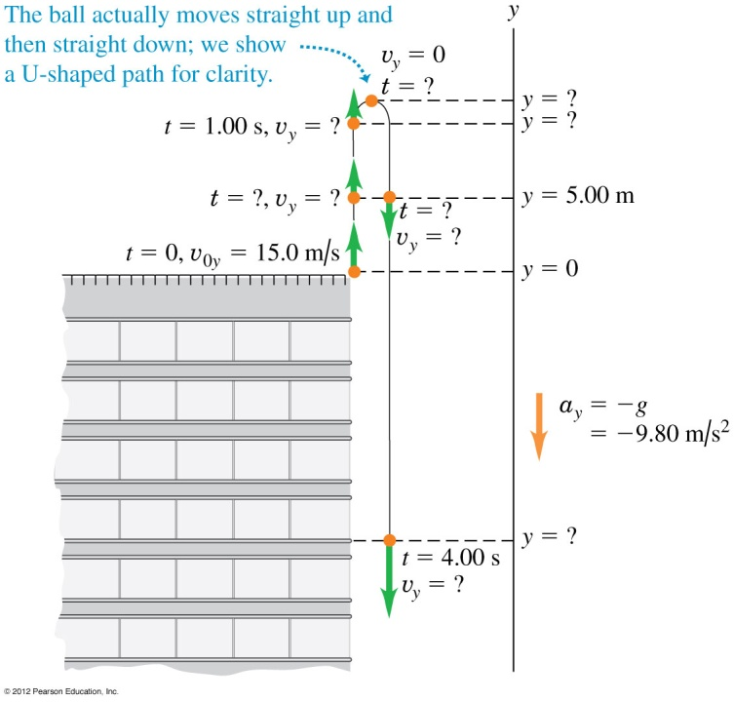
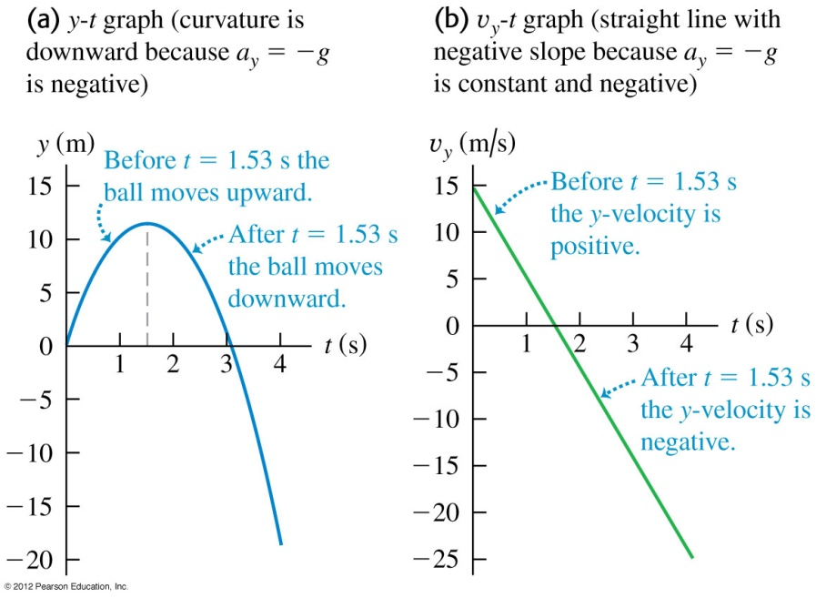
Example 4 - cont
Notes:
a) +10.1m, +5.2 m/s, -18.4 m, -24.2 m/s b) +11.3 m/s, -11.3 m/s c) +11.5 m d) -9.80 m/s² e) 3.36 s

Slide 27
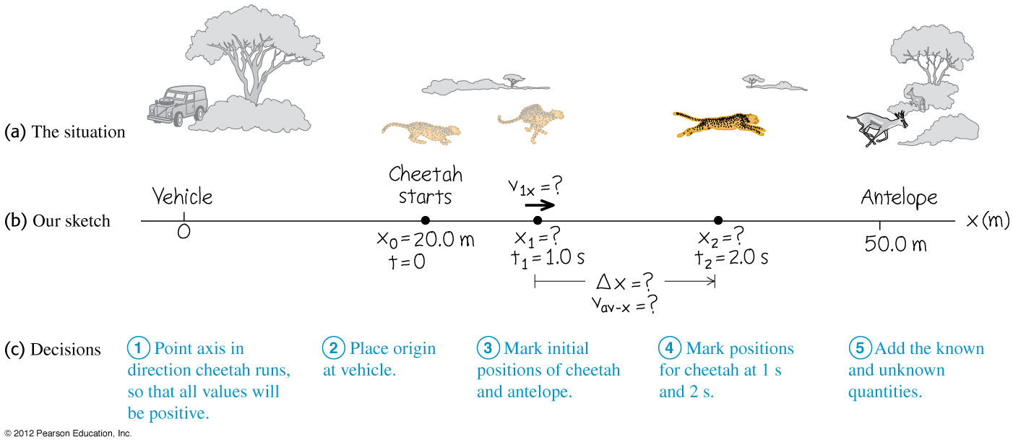
Example 5
A cheetah is crouched 20 m to the east of an observer in a vehicle. At t = 0 the cheetah begins to run due eastward toward an antelope that is 50 m to the east of the observer. During the first 2.0 s of the attack, the cheetah’s coordinate x varies with time according to the equation: x = 20 + 5.0t²
a) Find the cheetah’s displacement between t₁ = 1.0 s and t₂ = 2.0 s.
b) Find the average velocity during that interval.
c) Find the instantaneous velocity at t₁ = 1.0 s by taking ∆t = 0.1 s.
d) Derive an expression for the cheetah’s instantaneous velocity as a function of time and use it to find v_{x} at t = 1.0 s and t = 2.0 s.
Notes:
a) 15 m b) 15 m/s c) 10.5 m/s d) (10 m/s²)t, 10 m/s, 20 m/s

Slide 28
Instantaneous acceleration
The instantaneous acceleration is the rate of change of instantaneous velocity with time and is given by :
Unless specified, the term acceleration imply instantaneous acceleration.

Slide 29
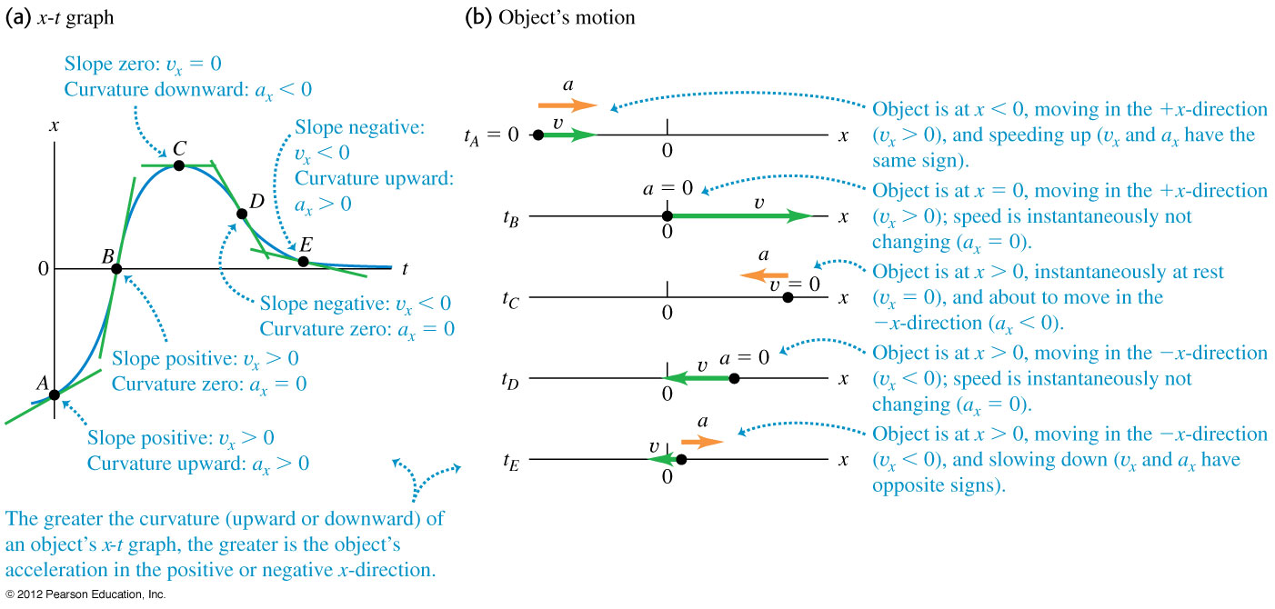
Instantaneous acceleration from x-t graph
The instantaneous acceleration is the second derivative of the x-t graph, i.e.

Slide 30
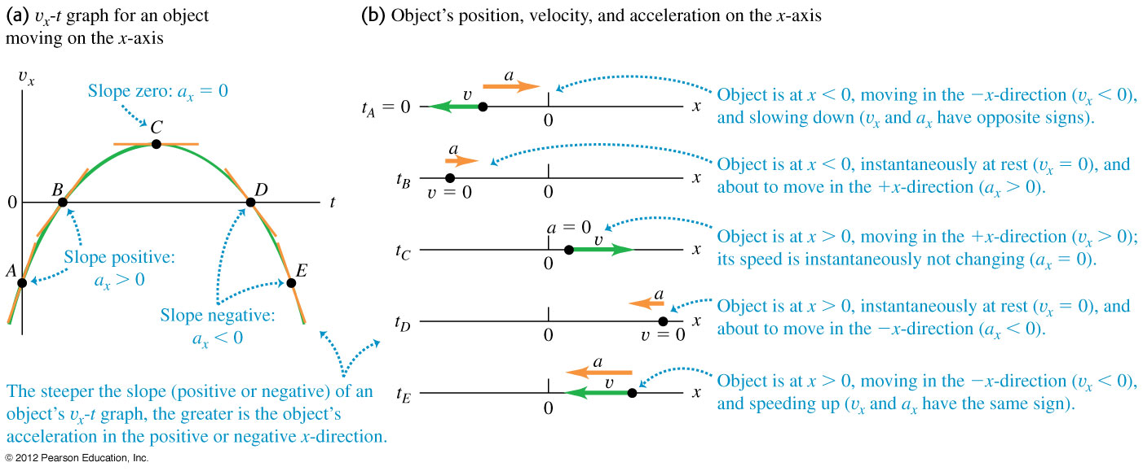
Instantaneous acceleration from v_{x}-t graph
The instantaneous acceleration is equal to the first derivative of a v_{x}-t graph, i.e.

Slide 31
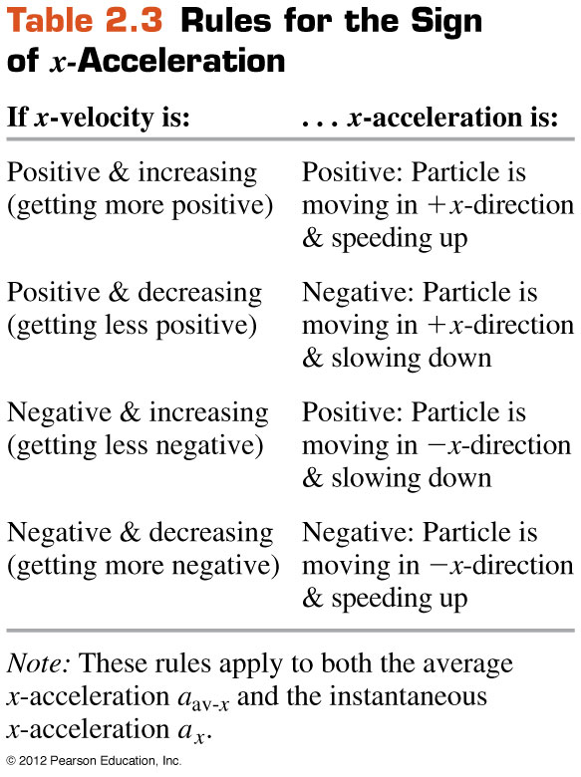
Rules for the sign of acceleration
Deceleration means a decrease in speed.
A negative acceleration does not always mean a decrease in speed.

Slide 32
Example 6
The velocity v_{x}, of a car at time t is given by the equation v_{x} = 60 + 0.50t² m/s.
a) Find the change in x-velocity of the car in the time interval t₁ = 1.0 s and t₂ = 3.0 s.
b) Find the average x-acceleration during this time interval.
c) Find the average acceleration at t₁ = 1.0 s by taking ∆t = 0.1 s.
d) Derive an expression for the instantaneous acceleration as a function of time and use it to find a_{x} at t = 1.0 s and t = 3.0 s.
Notes:
a) 4.0 m/s b) 2.0 m/s² c) 1.05 m/s² d) (1.0 m/s³) t, 1.0m/s², 3.0m/s²

Slide 33
Position in 2D
The position of an object in the x-y plane is given by .
It is represented by an arrow pointing from the origin to the object’s position P (x, y).
The size of is
The direction of with respect to the x-axis is
y
P (x, y)
0
x

Slide 34
Displacement in 2D
The displacement vector in the x-y plane is defined as .
It is represented by an arrow pointing from the head of to the head of .
The size of is
The direction of with respect to the x axis is
y
P₂ (x₂, y₂)
P₁ (x₁, y₁)
0
x

Slide 35
Average velocity in 2D
When a particle moves in the x-y plane, its average velocity during the time interval Δt is defined as
The size of is
The direction of is in the direction of .
y
P₂ (x₂, y₂)
P₁ (x₁, y₁)
0
x

Slide 36
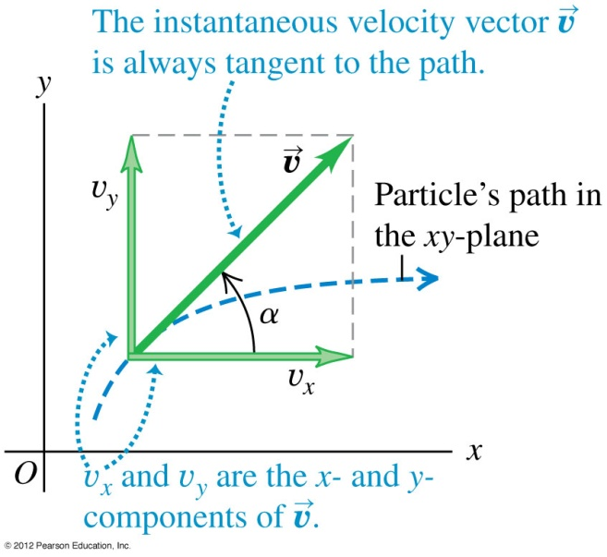
Instantaneous velocity in 2D
The instantaneous velocity is defined as
where is the position vector.
The instantaneous velocity is tangent to the particle's path.

Slide 37
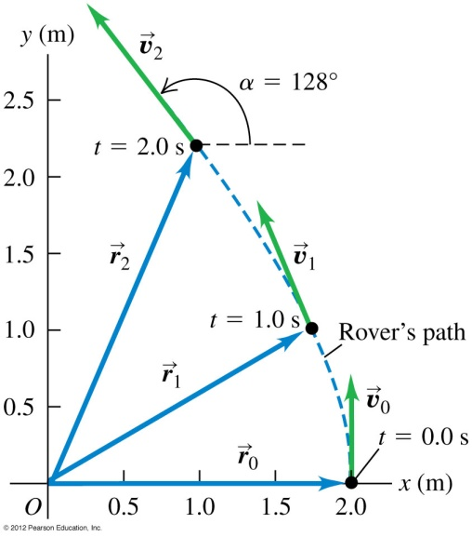
Example 7
A robotic vehicle, or rover, is exploring the surface of Mars. The landing craft is the origin of the co-ordinates, and the surrounding Martian surface lies in the x-y plane. The rover, which we represent as a point, has x- and y co-ordinates that vary with time :
a) Find the rover’s co-ordinates and its distance from the lander at t = 2.0 s.
b) Find the rover’s displacement and average velocity vectors during the time interval from t = 0.0 s to t = 2.0 s.
c) Derive a general expression for the rover’s instantaneous velocity vector.
d) Express the instantaneous velocity at t = 2.0 s in component form and also in terms of magnitude and direction.
Notes:
(1.0m, 2.2m), 2.4 m b) (-1.0 m)i + (2.2 m)j, (-0.50 m/s)i + (1.1 m/s)j, c) (-0.50 m/s²)ti + [(1.0 m/s) + (0.075 m/s³)t²] j
d) -1.0 m/s, 1.3 m/s, 1.6 m/s, 38º west of north

Slide 38
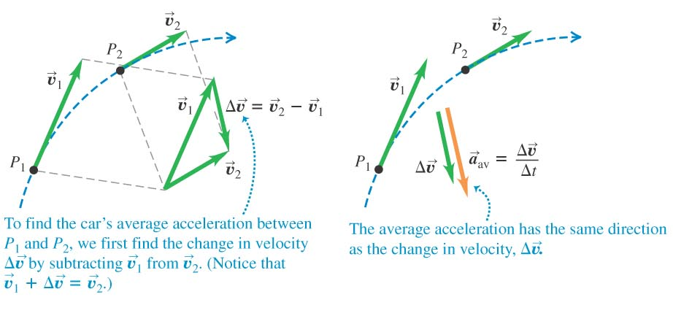
Average acceleration in 2D
The average acceleration is the change in instantaneous velocity divided by time t.
Its direction is the same as that of .

Slide 39
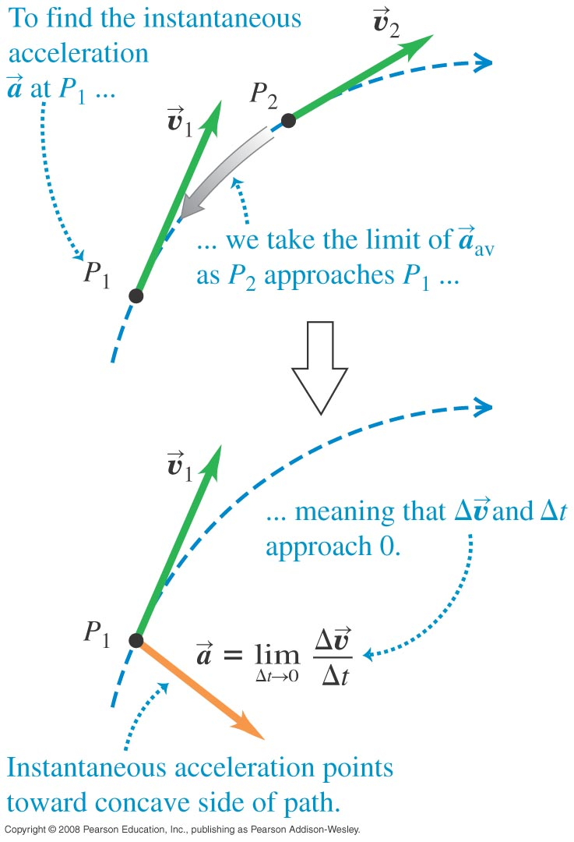
Instantaneous acceleration in 2D
The instantaneous acceleration is defined as
Its direction is towards the concave side of the path.
In terms of unit vectors

Slide 40
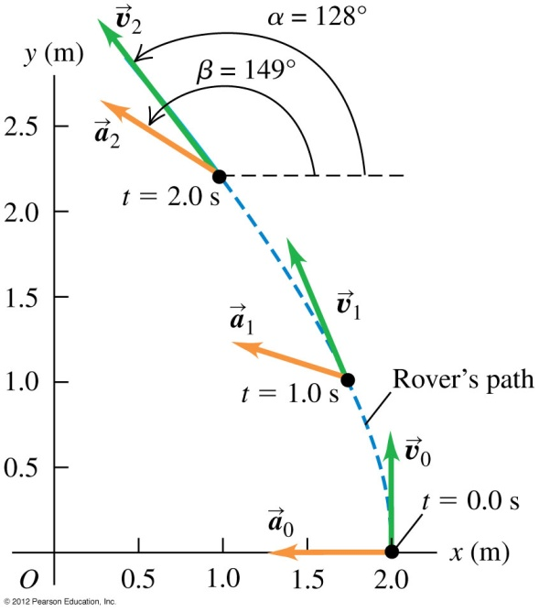
Example 8
A robotic vehicle, or rover, is exploring the surface of Mars. The landing craft is the origin of the co-ordinates, and the surrounding Martian surface lies in the x-y plane. The rover, which we represent as a point, has x- and y co-ordinates that vary with time :
a) Find the components of the average acceleration during the time interval from t = 0.0 s to t = 2.0 s.
b) Find the instantaneous acceleration at t = 2.0 s.
Notes:
-0.50 m/s², 0.15 m/s² b) (-0.50 m/s²)i + (0.30 m/s²)j

Slide 41
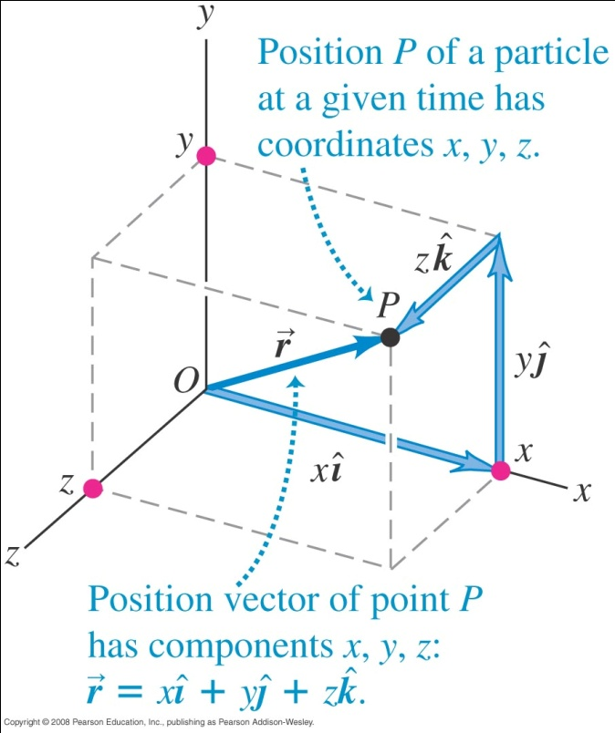
Position in 3D
The position of a particle is a vector from the origin of a co-ordinate system to the particle’s location P.
It is given by
E.g. If a particle is at x = 3 m, y = 4 m and z = 1 m, its position vector is

Slide 42
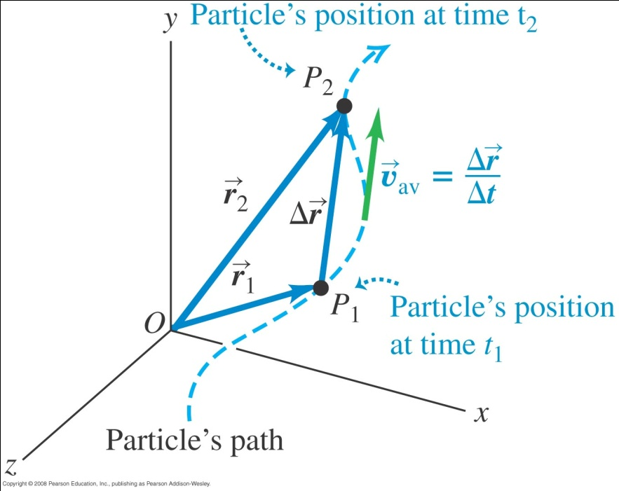
Displacement and average velocity in 3D
The displacement vector is defined as .
For a curved path, the size of the displacement vector is less than the distance travelled.
Displacement depends only on the start and end points.
The average velocity is defined as
It is in the same direction as the displacement vector.

Slide 43
Example 9
A particle takes 2.0 s to move from P₁ (3, 4, 1) to P₂ (6, 6, 3). What is the displacement and average velocity?

Slide 44
Instantaneous velocity in 3D
The instantaneous velocity in terms of unit vectors Is
Its direction is tangent to the path of the object.
The magnitude of the instantaneous velocity which is also the speed of the object is

Slide 45
Average acceleration in 3D
The average acceleration is the change in instantaneous velocity divided by time t.
Its direction is the same as that of .

Slide 46
Instantaneous acceleration in 3D
The instantaneous acceleration is defined as :
Its direction is towards the concave side of the path.
In terms of unit vectors
The size of is

Slide 47
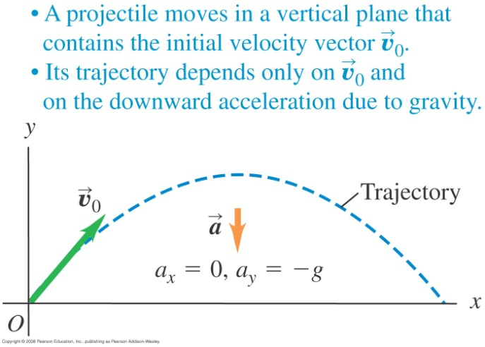
Projectile motion
A projectile is any body that is given an initial velocity and then follows a path determined entirely by the effects of gravity and air resistance.
We will set up equations for a projectile motion assuming no air resistance.
The initial velocity v₀ can be resolved into the x and y components in terms of the angle α₀, i.e.

Slide 48
If there is no air resistance, the horizontal velocity is constant.
The horizontal distance travelled in time t is .
Because of gravity, the vertical velocity varies as
The vertical distance travelled is in time t is
Eliminating t from the equation for x and y, we have,
This shows that the object moves in a parabolic path.

Slide 49
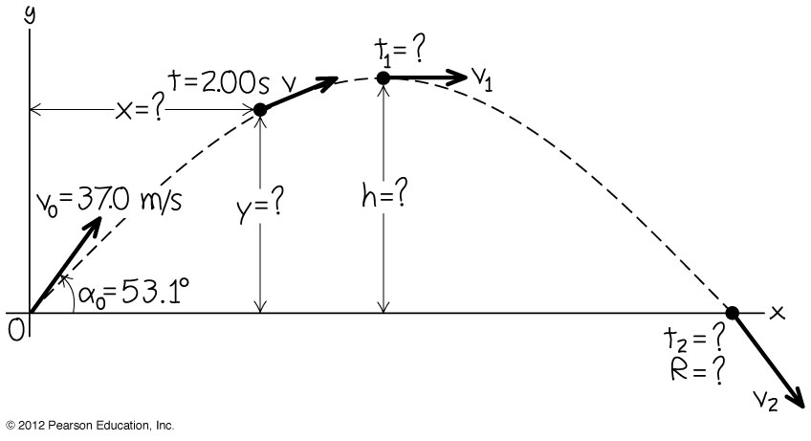
Example 10
A batter hits a baseball so that it leaves the bat at speed v₀ = 37.0 m/s at an angle α₀ = 53.1º.
a) Find the position of the ball and its velocity at t = 2.00 s.
b) Find the time when the ball reaches the highest point of its flight and its height h, at this time.
c) Find the horizontal range R which is the maximum horizontal distance travelled by the ball.
Notes:
a) (44.4 m, 39.6 m), 24.4 m/s, 24.2º above the horizontal b) 3.02 s, 44.7 m c) 134 m

Slide 50
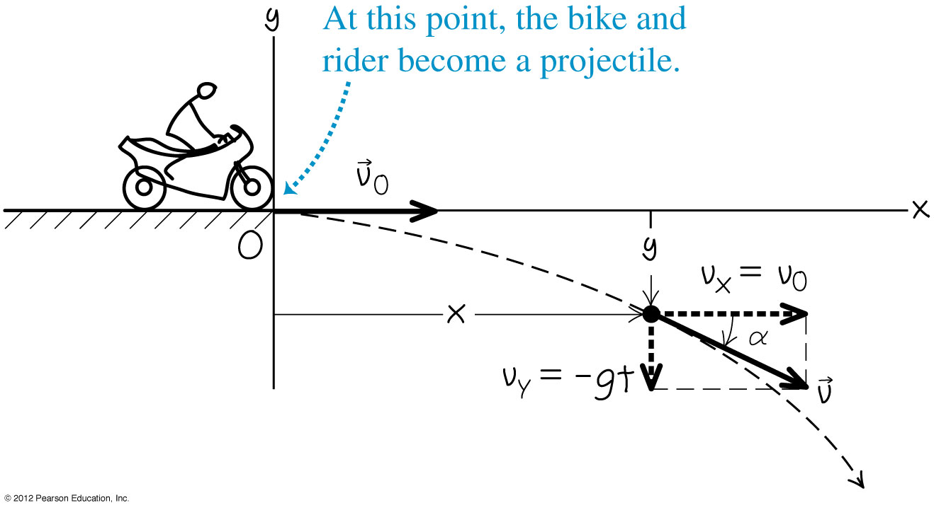
Example 11
A motorcycle stunt rider rides off the edge of a cliff. Just at the edge his velocity is horizontal, with magnitude 9.0 m/s. Find the motorcycle’s (a) position (b) distance from the edge of the cliff and (c) velocity 0.5 s after it leaves the edge of the cliff.
Notes:
a) (4.5 m, -1.2 m) b) 4.7 m c) 10.2 m/s, 29º below horizontal

Slide 51
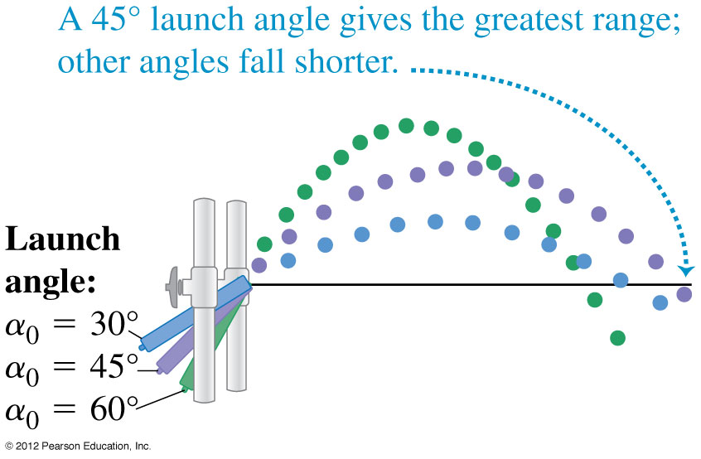
Example 12
Find the maximum height h and horizontal range R of a projectile launched with speed v₀ at and initial angle α₀ between 0º and 90º .
b) For a given v_{0,} what value of α₀ gives maximum height?
c) What value of α₀ gives maximum horizontal range?
Notes:
a) v₀²sin²α₀/2g, v₀²sin2α₀/g b) 90º c) 45º

Slide 52
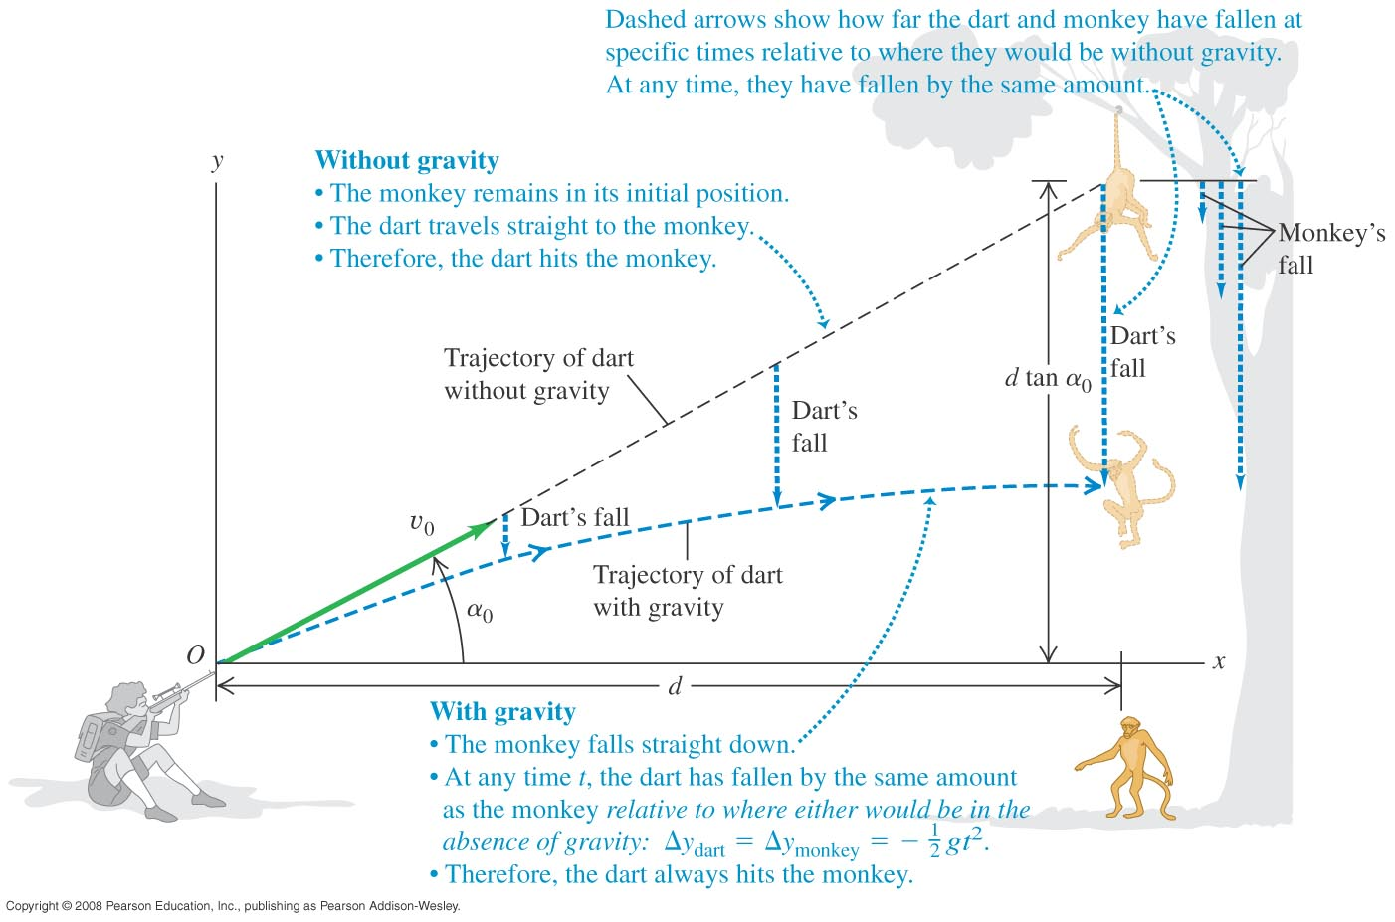
Example 13
A monkey escapes from the zoo and climbs a tree. After failing to entice the monkey down, the zookeeper fires a tranquilizer dart directly at the monkey (see below figure). The monkey lets go at the instant the dart leaves the gun. Show that the dart will always hit the monkey, provided that the dart reaches the monkey before the monkey hits the ground and runs away.

Slide 53
Motion with a non-uniform acceleration
The following equations are useful in the case of non-uniform acceleration.

Slide 54
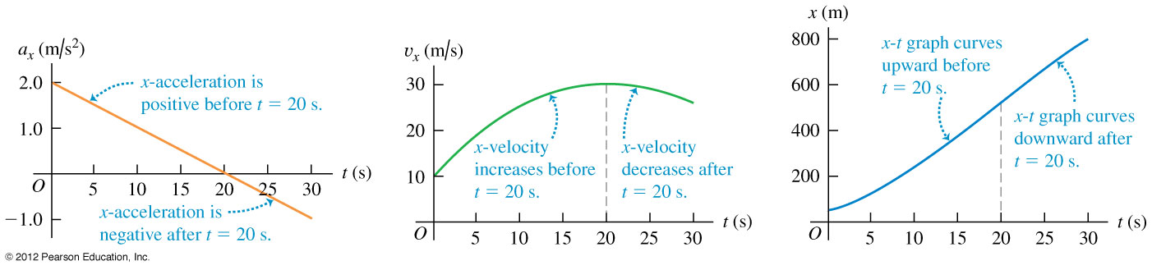
Example 14
Sally is driving along a straight highway. At t = 0, when she is moving at 10 m/s in the positive x-direction, she passes a sign-post at x = 50 m. Her x-acceleration as a function of time is a_{x} = 2.0 - 0.10t m/s²
a) Find her x-velocity v_{x} and position x as functions of time. b) When is her x-velocity maximum?
c) What is that maximum x-velocity?
Notes:
v_{x} = 10 m/s + (2.0 m/s²) t - (0.5 m/s³)t² , x =50 m + (10 m/s)t + (2.0 m/s²) t²/2 - (0.5 m/s³)t³/6 b) 20 s
c) 30 m/s d) 517 m

Slide 55
End of chapter

